Slide 1
Simple 3D Software based on ImGui
Reporter:李孟宸

Slide 2
Introduction
Create a simple 3D software
It will have some basic functions
Create basic objects(Ex:sphere, cube..)
Translate, rotate, scale
Color or texture

Slide 3
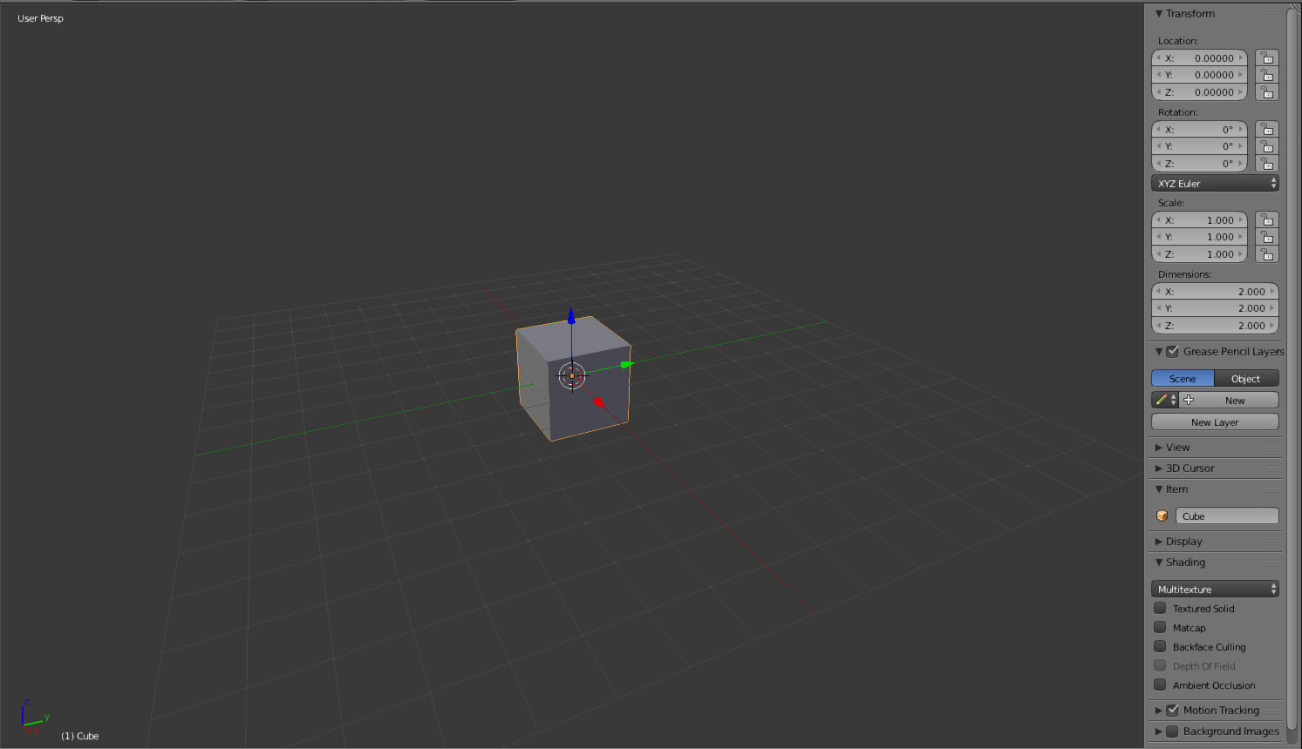
Goal

Slide 4
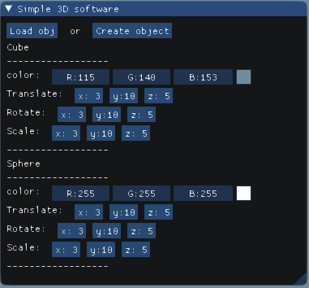
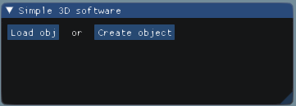
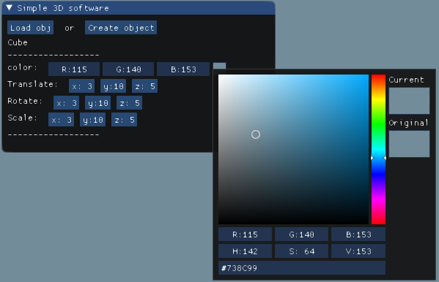
GUI

Slide 5
File dialog system

Slide 6
Advanced
Do above functions directly on the screen
Use mouse event and keyboard event to complete above functions

Slide 7
Reference
https://github.com/ocornut/imgui
https://learnopengl.com/Getting-started/Textures
http://www.opengl-tutorial.org/beginners-tutorials/tutorial-6-keyboard-and-mouse/

Slide 8
Thanks for your listening

